Slide 1

School of Computer Engineering KIIT deemed to be University
Intro to Python basics
(6thSemester)

Slide 2
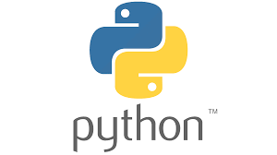
What is Python
Python is a general purpose, dynamic, high-level, and interpreted programming language. It supports Object Oriented programming approach to develop applications. It is simple and easy to learn and provides lots of high-level data structures.
Python is easy to learn yet powerful and versatile scripting language, which makes it attractive for Application Development.
Python supports multiple programming pattern, including object-oriented, and functional or procedural programming styles.

Slide 3
What is Python cont
Python is not intended to work in a particular area, such as web programming. That is why it is known as multipurpose programming language because it can be used with web, enterprise, 3D CAD, etc.
We don't need to use data types to declare variable because it is dynamically typed so we can write a=10 to assign an integer value in an integer variable.
Python makes the development and debugging fast because there is no compilation step included in Python development, and edit-test-debug cycle is very fast.

Slide 4
Java vs Python Program
public class HelloWorld
{
public static void main(String[] args)
{
System.out.println("Hello World");
}
}
print("Hello World")
Both programs will print the same result, but it takes only one statement without using a semicolon or curly braces in Python.

Slide 5
Python Basic Syntax
def func():
statement 1
statement 2
…………………
…………………
statement N
Here is no use of curly braces or semicolon in Python programming language. It is English-like language.

Slide 6
Python History
Python was invented by Guido van Rossum in 1991 at CWI in Netherland.
There is also a fact behind the choosing name Python. Guido van Rossum was a fan of the popular BBC comedy show of that time, "Monty Python's Flying Circus". So he decided to pick the name Python for his newly created programming language.
Python has the vast community across the world and releases its version within the short period.

Slide 7
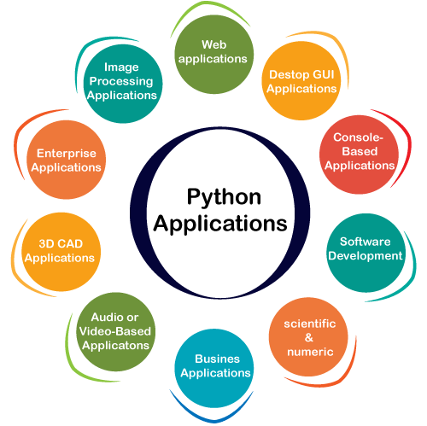
Where is Python used?
Data Science
Date Mining
Desktop Applications
Console-based Applications
Mobile Applications
Software Development
Artificial Intelligence
Web Applications
Enterprise Applications
3D CAD Applications
Machine Learning
Computer Vision or Image Processing Applications.
Speech Recognitions

Slide 8
Python Popular Frameworks and Libraries
Web development (Server-side) - Django Flask, Pyramid, CherryPy
GUIs based applications - Tk, PyGTK, PyQt, PyJs, etc.
Machine Learning - TensorFlow, PyTorch, Scikit-learn, Matplotlib, Scipy, etc.
Mathematics - Numpy, Pandas, etc.

Slide 9
Python Version List
Python Version | Released Date
Python 1.0 | Jan-94
Python 1.5 | 31-Dec-97
Python 1.6 | 05-Sep-00
Python 2.0 | 16-Oct-00
Python 2.1 | April 17, 2001
Python 2.2 | 21-Dec-01
Python 2.3 | 29-Jul-03
Python 2.4 | 30-Nov-04
Python 2.5 | 19-Sep-06
Python 2.6 | 01-Oct-08
Python 2.7 | 03-Jul-10
Python 3.0 | 03-Dec-08
Python 3.1 | 27-Jun-09
Python 3.2 | 20-Feb-11
Python 3.3 | 29-Sep-12
Python 3.4 | 16-Mar-14
Python 3.5 | 13-Sep-15
Python 3.6 | 23-Dec-16
Python 3.7 | 27-Jun-18
Python 3.8 | 14-Oct-19

Slide 10
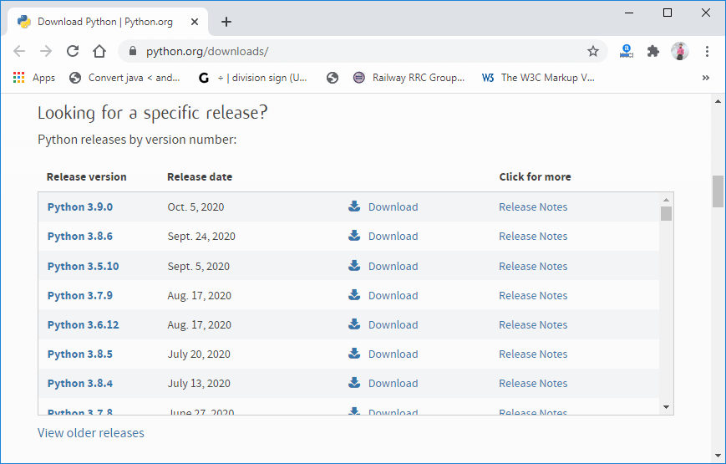
Installation on Windows
Visit the link https://www.python.org/downloads/ to download the latest release of Python.

Slide 11
Taking Input to the User
Python provides the input() function which is used to take input from the user. Let's understand the following example.
Example -
name = input("Enter a name of student:")
print("The student name is: ", name)
Example -
a = int(input("Enter first number: "))
b = int(input("Enter second number: "))
print(a+b)

Slide 12
Declaring Variable and Assigning Values
Python does not bind us to declare a variable before using it in the application. It allows us to create a variable at the required time.
We don't need to declare explicitly variable in Python. When we assign any value to the variable, that variable is declared automatically.
The equal (=) operator is used to assign value to a variable.
Object References
It is necessary to understand how the Python interpreter works when we declare a variable. The process of treating variables is somewhat different from many other programming languages.
Python is the highly object-oriented programming language; that's why every data item belongs to a specific type of class.

Slide 13
print("John")
Output:
John
In the above print statement, we have created a string object.
type("John")
Output:
<class 'str'>

Slide 14


In Python, variables are a symbolic name that is a reference or pointer to an object.
The variables are used to denote objects by that name.
a = 50
Suppose we assign the integer value 50 to a new variable b.
The variable b refers to the same object that a points to because Python does not create another object.

Slide 15
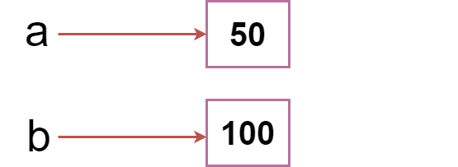
a = 50
b =100
Python manages memory efficiently if we assign the same variable to two different values.

Slide 16
Object Identity
In Python, every created object identifies uniquely in Python. Python provides the guaranteed that no two objects will have the same identifier. The built-in id() function, is used to identify the object identifier. Consider the following example.
a = 50
b = a
print(id(a))
print(id(b))
# Reassigned variable a
a = 500
print(id(a))
Output:
140734982691168
140734982691168
2822056960944

Slide 17
Python Data Types
Variables can hold values, and every value has a data-type. Python is a dynamically typed language; hence we do not need to define the type of the variable while declaring it. The interpreter implicitly binds the value with its type.
a = 5
The variable a holds integer value five and we did not define its type. Python interpreter will automatically interpret variables a as an integer type

Slide 18
a=10
b="Hi Python"
c = 10.5
print(type(a))
print(type(b))
print(type(c))
Output:
<type 'int'>
<type 'str'>
<type 'float'>

Slide 19
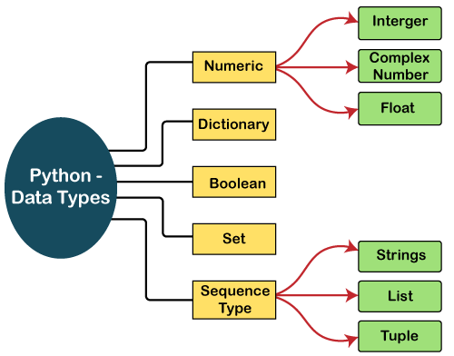
Standard data types
A variable can hold different types of values. For example, a person's name must be stored as a string whereas its id must be stored as an integer.
Python provides various standard data types that define the storage method on each of them. The data types defined in Python are given below.

Slide 20
Numbers
Number stores numeric values. The integer, float, and complex values belong to a Python Numbers data-type.
Python provides the type() function to know the data-type of the variable. Similarly, the isinstance() function is used to check an object belongs to a particular class.
Python creates Number objects when a number is assigned to a variable. For example;
a = 5
print("The type of a", type(a))
b = 40.5
print("The type of b", type(b))
c = 1+3j
print("The type of c", type(c))
print(" c is a complex number", isinstance(1+3j,complex))

Slide 21
String
str1 = 'welcome to KIIT' #string str1
str2 = ' how are you' #string str2
print (str1[0:2]) #printing first two character using slice operator
print (str1[4]) #printing 4th character of the string
print (str1*2) #printing the string twice
print (str1 + str2) #printing the concatenation of str1 and str2

Slide 22
List
Python Lists are similar to arrays in C. However, the list can contain data of different types. The items stored in the list are separated with a comma (,) and enclosed within square brackets [].
We can use slice [:] operators to access the data of the list. The concatenation operator (+) and repetition operator (*) works with the list in the same way as they were working with the strings.

Slide 23
List
list1 = [1, "hi", "Python", 2]
#Checking type of given list
print(type(list1))
#Printing the list1
print (list1)
# List slicing
print (list1[3:])
# List slicing
print (list1[0:2])
# List Concatenation using + operator
print (list1 + list1)
# List repetation using * operator
print (list1 * 3)

Slide 24
Tuple
A tuple is similar to the list in many ways. Like lists, tuples also contain the collection of the items of different data types. The items of the tuple are separated with a comma (,) and enclosed in parentheses ().
A tuple is a read-only data structure as we can't modify the size and value of the items of a tuple.

Slide 25
Dictionary
Dictionary is an unordered set of a key-value pair of items. It is like an associative array or a hash table where each key stores a specific value. Key can hold any primitive data type, whereas value is an arbitrary Python object.
The items in the dictionary are separated with the comma (,) and enclosed in the curly braces {}.

Slide 26
Dictionary
d = {1:'Jimmy', 2:'Alex', 3:'john', 4:'mike'}
# Printing dictionary
print (d)
# Accesing value using keys
print("1st name is "+d[1])
print("2nd name is "+ d[4])
print (d.keys())
print (d.values())

Slide 27
The if statement
num = int(input("enter the number?"))
if num%2 == 0:
print("Number is even")
a = int(input("Enter a? "));
b = int(input("Enter b? "));
c = int(input("Enter c? "));
if a>b and a>c:
print("a is largest");
if b>a and b>c:
print("b is largest");
if c>a and c>b:
print("c is largest");

Slide 28
marks = int(input("Enter the marks? "))
f marks > 85 and marks <= 100:
print("Congrats ! you scored grade A ...")
lif marks > 60 and marks <= 85:
print("You scored grade B + ...")
lif marks > 40 and marks <= 60:
print("You scored grade B ...")
lif (marks > 30 and marks <= 40):
print("You scored grade C ...")
lse:
print("Sorry you are fail ?")

Slide 29
The for Loop
Python's for loop is designed to repeatedly execute a code block while iterating through a list, tuple, dictionary, or other iterable objects of Python. The process of traversing a sequence is known as iteration.
Syntax of the for Loop
for value in sequence:
{ code block }
In this case, the variable value is used to hold the value of every item present in the sequence before the iteration begins until this particular iteration is completed.
Loop iterates until the final item of the sequence are reached.

Slide 30
# Python program to show how the for loop works
# Creating a sequence which is a tuple of numbers
numbers = [4, 2, 6, 7, 3, 5, 8, 10, 6, 1, 9, 2]
# variable to store the square of the number
square = 0
# Creating an empty list
squares = []
# Creating a for loop
for value in numbers:
square = value ** 2
squares.append(square)
print("The list of squares is", squares)

Slide 31
# Python program to show how if-else statements work
string = "Python Loop"
# Initiating a loop
for s in a string:
# giving a condition in if block
if s == "o":
print("If block")
# if condition is not satisfied then else block will be executed
else:
print(s)

Slide 32
What is NumPy
NumPy stands for numeric python which is a python package for the computation and processing of the multidimensional and single dimensional array elements.
Travis Oliphant created NumPy package in 2005 by injecting the features of the ancestor module Numeric into another module Numarray.
It is an extension module of Python which is mostly written in C. It provides various functions which are capable of performing the numeric computations with a high speed.
NumPy provides various powerful data structures, implementing multi-dimensional arrays and matrices. These data structures are used for the optimal computations regarding arrays and matrices.

Slide 33
The need of NumPy
With the revolution of data science, data analysis libraries like NumPy, SciPy, Pandas, etc. have seen a lot of growth. With a much easier syntax than other programming languages, python is the first choice language for the data scientist.
NumPy provides a convenient and efficient way to handle the vast amount of data. NumPy is also very convenient with Matrix multiplication and data reshaping.
NumPy performs array-oriented computing.
It efficiently implements the multidimensional arrays.
It performs scientific computations.
It is capable of performing Fourier Transform and reshaping the data stored in multidimensional arrays.
NumPy provides the in-built functions for linear algebra and random number generation.

Slide 34
The need of NumPy
If you are going to work on data analysis or machine learning projects, then having a solid understanding of numpy is nearly mandatory.
Because other packages for data analysis (like pandas) is built on top of numpy and the scikit-learn package which is used to build machine learning applications works heavily with numpy as well.
So what does numpy provide?
At the core, numpy provides the excellent ndarray objects, short for n-dimensional arrays.

Slide 35
You might wonder, ‘I can store numbers and other objects in a python list itself and do all sorts of computations and manipulations through list comprehensions, for-loops etc. What do I need a numpy array for?’
The key difference between an array and a list is, arrays are designed to handle vectorized operations while a python list is not.
That means, if you apply a function it is performed on every item in the array, rather than on the whole array object.

Slide 36
Let’s suppose you want to add the number 2 to every item in the list.
list1 + 2 # error
That was not possible with a list. But you can do that on a ndarray.
# Add 2 to each element of arr1d
arr1d + 2
#> array([2, 3, 4, 5, 6])
Once a numpy array is created, you cannot increase its size. To do so, you will have to create a new array..
So many advantages..............................

Slide 37
NumPy Environment Setup
NumPy doesn't come bundled with Python. We have to install it using the python pip installer. Execute the following command.
$ pip install numpy

Slide 38
NumPy Ndarray
Ndarray is the n-dimensional array object defined in the numpy which stores the collection of the similar type of elements.
The ndarray object can be accessed by using the 0 based indexing. Each element of the Array object contains the same size in the memory.
Creating a ndarray object
The ndarray object can be created by using the array routine of the numpy module. For this purpose, we need to import the numpy.
>>> a = numpy.array

Slide 39
Creating Arrays:
- np.array(): Convert lists to arrays.
- np.zeros(), np.ones(): Generate arrays with zeros or ones.
- np.arange(), np.linspace(): Create arrays with specified ranges.
Array Operations:
- Element-wise operations: +, -, *, /.
- Dot Product: np.dot() or @ operator.
- Mathematical functions: np.sin(), np.cos(), np.exp(), etc.
Indexing and Slicing:
- Access elements using indices.
- Slice arrays for subarrays.
.

Slide 40
Shape and Reshape:
- Check array dimensions using shape.
- Change array shape with reshape().
Statistical Operations:
- np.mean(), np.sum(), np.std(), etc.
Broadcasting:
- Implicit element-wise operations on arrays of different shapes

Slide 41
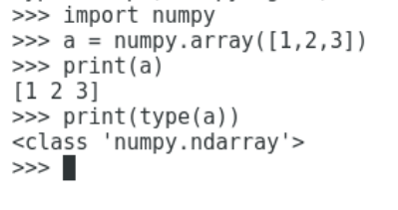
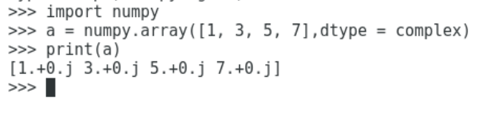
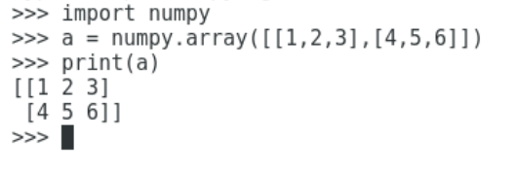

Slide 42
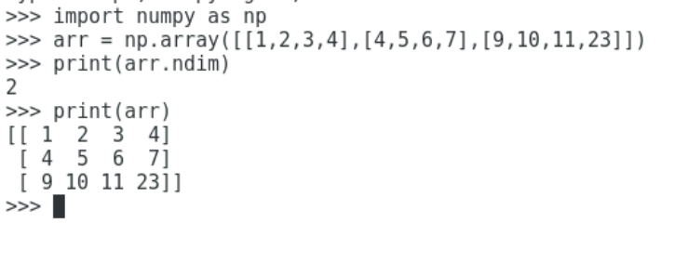

Slide 43
Finding the size of each array element
The itemsize function is used to get the size of each array item. It returns the number of bytes taken by each array element.
#finding the size of each item in the array
import numpy as np
a = np.array([[1,2,3]])
print("Each item contains",a.itemsize,"bytes")
Output:
Each item contains 8 bytes.

Slide 44
Finding the data type of each array item
import numpy as np
a = np.array([[1,2,3]])
print("Each item is of the type",a.dtype)
Output:
Each item is of the type int64

Slide 45
Finding the shape and size of the array
import numpy as np
a = np.array([[1,2,3,4,5,6,7]])
print("Array Size:",a.size)
print("Shape:",a.shape)
Output:
Array Size: 7
Shape: (1, 7)

Slide 46
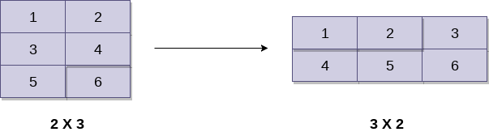
Reshaping the array objects
import numpy as np
a = np.array([[1,2],[3,4],[5,6]])
print("printing the original array..")
print(a)
a=a.reshape(2,3)
print("printing the reshaped array..")
print(a)

Slide 47
Finding the maximum, minimum, and sum of the array elements
import numpy as np
a = np.array([1,2,3,10,15,4])
print("The array:",a)
print("The maximum element:",a.max())
print("The minimum element:",a.min())
print("The sum of the elements:",a.sum())

Slide 48
NumPy Array Iteration
NumPy provides an iterator object, i.e., nditer which can be used to iterate over the given array using python standard Iterator interface.
import numpy as np
a = np.array([[1,2,3,4],[2,4,5,6],[10,20,39,3]])
print("Printing array:")
print(a);
print("Iterating over the array:")
for x in np.nditer(a):
print(x,end=' ')

Slide 49
1. *Creating a 1D Array:*
python
import numpy as np
# Using np.array()
array_1d = np.array([1, 2, 3, 4, 5])
2. *Creating a 2D Array:*
python
import numpy as np
# Using np.array() with nested lists
array_2d = np.array([[1, 2, 3], [4, 5, 6], [7, 8, 9]])

Slide 50
3. *Creating Arrays with Zeros or Ones:*
python
import numpy as np
# Array of zeros
zeros_array = np.zeros(5) # 1D array of five zeros
# 2D array of ones
ones_array_2d = np.ones((3, 4)) # 3x4 array of ones
4. *Creating a Range of Values:*
python
import numpy as np
# Using np.arange()
range_array = np.arange(0, 10, 2) # Array from 0 to 10 (exclusive) with step 2
# Using np.linspace()
linspace_array = np.linspace(0, 1, 5) # Array of 5 evenly spaced values between 0 and 1

Slide 51
Pandas
Pandas is defined as an open-source library that provides high-performance data manipulation in Python.
The name of Pandas is derived from the word Panel Data, which means an Econometrics from Multidimensional data.
It is used for data analysis in Python and developed by Wes McKinney in 2008.

Slide 52
Data analysis requires lots of processing, such as restructuring, cleaning or merging, etc.
There are different tools are available for fast data processing, such as Numpy, Scipy, Cython, and Panda.
But we prefer Pandas because working with Pandas is fast, simple and more expressive than other tools.
Pandas is built on top of the Numpy package, means Numpy is required for operating the Pandas.

Slide 53
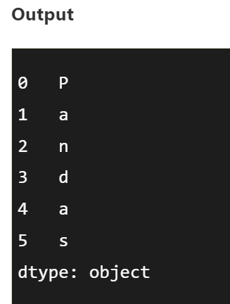
Python Pandas Data Structure
The Pandas provides two data structures for processing the data, i.e., Series and DataFrame.
1) Series
It is defined as a one-dimensional array that is capable of storing various data types. The row labels of series are called the index. We can easily convert the list, tuple, and dictionary into series using "series' method.
Data: It can be any list, dictionary, or scalar value.
import pandas as pd
import numpy as np
info = np.array(['P','a','n','d','a','s'])
a = pd.Series(info)
print(a)

Slide 54
2)Python Pandas DataFrame
It is a widely used data structure of pandas and works with a two-dimensional array with labeled axes (rows and columns).
DataFrame is defined as a standard way to store data and has two different indexes, i.e., row index and column index.

Slide 55
Loading and Exploring the Dataset:
import pandas as pd
# Load the Iris dataset
iris_df = pd.read_csv('iris.csv')
# Display the first few rows of the dataset
print(iris_df.head())
# Get summary statistics of the dataset
print(iris_df.describe())
# Check the data types and missing values
print(iris_df.info())

Slide 56
Filtering Data:
# Filter rows where 'sepal_length' is greater than 5
filtered_data = iris_df[iris_df['sepal_length'] > 5]
# Filter rows where 'species' is 'setosa'
setosa_data = iris_df[iris_df['species'] == 'setosa']

Slide 57
# Group data by 'species' and calculate the mean of each numerical column
species_means = iris_df.groupby('species').mean()
# Sort data by 'petal_length' in descending order
sorted_data = iris_df.sort_values(by='petal_length', ascending=False)
# Check for missing values
print(iris_df.isnull().sum())
# Drop rows with missing values
cleaned_data = iris_df.dropna()

Slide 58
sklearn
scikit-learn, commonly abbreviated as sklearn, is a popular open-source machine learning library for Python.
It provides a wide range of tools for machine learning tasks such as classification, regression, clustering, dimensionality reduction, and model selection.
sklearn is built on top of other Python libraries such as NumPy, SciPy, and Matplotlib, making it easy to integrate into existing data science workflows. It also features a clean and consistent API, making it user-friendly for both beginners and experienced machine learning practitioners.
Some of the key functionalities provided by sklearn include algorithms for training models, tools for preprocessing data, utilities for model evaluation, and various datasets for experimentation and learning.
Overall, sklearn is a powerful and versatile library that has contributed significantly to the growth and adoption of machine learning in Python.

Slide 59
scikit-learn (sklearn) can be used
Classification*: Train a classifier to predict categories or labels for a given dataset. For example, you can use the LogisticRegression or RandomForestClassifier to classify emails as spam or not spam.
2. *Regression*: Fit a regression model to predict continuous outcomes. You might use the LinearRegression model to predict house prices based on features like square footage, number of bedrooms, etc.
3. *Clustering*: Group similar data points together without using predefined labels. You can use algorithms like KMeans to cluster customers based on their purchasing behavior.
4. *Dimensionality Reduction*: Reduce the number of features in a dataset while preserving its essential information. The PCA (Principal Component Analysis) algorithm can be used for this purpose, for instance, to visualize high-dimensional data.
5. *Model Selection and Evaluation*: scikit-learn provides tools for selecting the best model and evaluating its performance. For example, you can use GridSearchCV to tune hyperparameters of a model and cross_val_score to estimate its performance using cross-validation.

Slide 60
from sklearn.datasets import load_iris
from sklearn.model_selection import train_test_split
from sklearn.ensemble import RandomForestClassifier
from sklearn.metrics import accuracy_score
iris = load_iris()
X = iris.data
y = iris.target
# Split the dataset into training and testing sets
X_train, X_test, y_train, y_test = train_test_split(X, y, test_size=0.2, random_state=42)
# Initialize the RandomForestClassifier
clf = RandomForestClassifier()
# Train the classifier
clf.fit(X_train, y_train)
# Make predictions on the test set
predictions = clf.predict(X_test)
# Calculate accuracy
accuracy = accuracy_score(y_test, predictions)
print("Accuracy:", accuracy)

Slide 61
OpenCV?

Slide 62

What is OpenCV?
OpenCV is a Python open-source library, which is used for computer vision in Artificial intelligence, Machine Learning, face recognition, etc.
In OpenCV, the CV is an abbreviation form of a computer vision, which is defined as a field of study that helps computers to understand the content of the digital images such as photographs and videos.
The purpose of computer vision is to understand the content of the images. It extracts the description from the pictures, which may be an object, a text description, and three-dimension model, and so on.

Slide 63
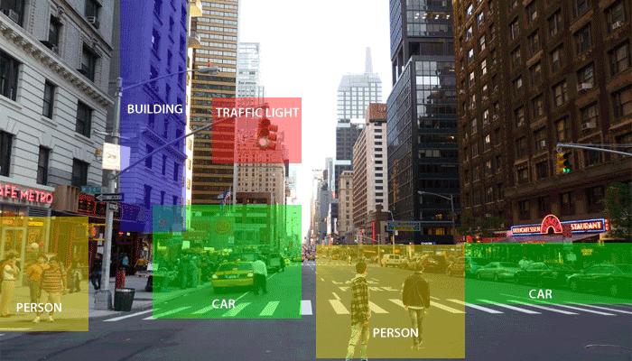
For example, cars can be facilitated with computer vision, which will be able to identify and different objects around the road, such as traffic lights, pedestrians, traffic signs, and so on, and acts accordingly.

Slide 64
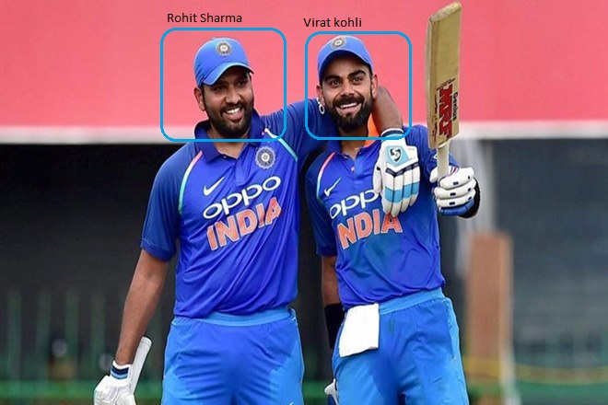
Computer vision allows the computer to perform the same kind of tasks as humans with the same efficiency. There are a two main task which are defined below:
Object Classification - In the object classification, we train a model on a dataset of particular objects, and the model classifies new objects as belonging to one or more of your training categories.
Object Identification - In the object identification, our model will identify a particular instance of an object - for example, parsing two faces in an image and tagging one as Virat Kohli and other one as Rohit Sharma.

Slide 65
History
OpenCV stands for Open Source Computer Vision Library, which is widely used for image recognition or identification. It was officially launched in 1999 by Intel. It was written in C/C++ in the early stage, but now it is commonly used in Python for the computer vision as well.
The first alpha version of OpenCV was released for the common use at the IEEE Conference on Computer Vision and Pattern Recognition in 2000, and between 2001 and 2005, five betas were released. The first 1.0 version was released in 2006.

Slide 66
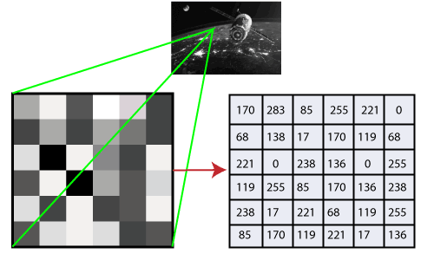
How does computer recognize the image?
Human eyes provide lots of information based on what they see.
Machines are facilitated with seeing everything, convert the vision into numbers and store in the memory.
Here the question arises how computer convert images into numbers. So the answer is that the pixel value is used to convert images into numbers.
A pixel is the smallest unit of a digital image or graphics that can be displayed and represented on a digital display device.

Slide 67
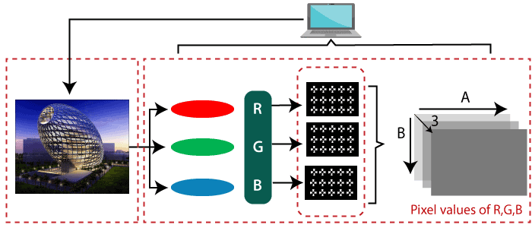
There are two common ways to identify the images:
1. Grayscale
Grayscale images are those images which contain only two colors black and white. The contrast measurement of intensity is black treated as the weakest intensity, and white as the strongest intensity. When we use the grayscale image, the computer assigns each pixel value based on its level of darkness.
2. RGB
An RGB is a combination of the red, green, blue color which together makes a new color. The computer retrieves that value from each pixel and puts the results in an array to be interpreted.

Slide 68
Install OpenCV in the Windows via pip
pip install opencv-python

Slide 69
OpenCV imread function
The imread() function loads image from the specified file and returns it. The syntax is:
cv2.imread(filename[,flag])
Parameters:
filename: Name of the file to be loaded
flag: The flag specifies the color type of a loaded image:
CV_LOAD_IMAGE_ANYDEPTH - If we set it as flag, it will return 16-bits/32-bits image when the input has the corresponding depth, otherwise convert it to 8-BIT.
CV_LOAD_IMAGE_COLOR - If we set it as flag, it always return the converted image to the color one.
C V_LOAD_IMAGE_GRAYSCALE - If we set it as flag, it always convert image into the grayscale.

Slide 70
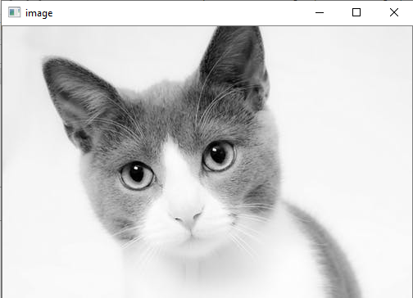
OpenCV imread function
#importing the opencv module
import cv2
# using imread('path') and 0 denotes read as grayscale image
img = cv2.imread(r'C:\Users\SRM\cat.jpeg',1)
#This is using for display the image
cv2.imshow('image',img)
cv2.waitKey(3) # This is necessary to be required so that the image doesn't close immediately.
#It will run continuously until the key press.
cv2.destroyAllWindows()

Slide 71
OpenCV Save Images
OpenCV imwrite() function is used to save an image to a specified file. The file extension defines the image format. The syntax is the following:
cv2.imwrite(filename, img[,params])
import cv2
# read image as grey scale
img = cv2.imread(r'C:\Users\SRM\cat.jpeg', 1)
# save image
status = cv2.imwrite(r'C:\Users\SRM\cat.jpeg', img)
print("Image written to file-system : ", status)

Slide 72
OpenCV Basic Operation on Images
Accessing and Modifying pixel values
We can retrieve a pixel value by its row and column coordinates. It returns an array of blue, green, red values of the BGR image. It returns the corresponding intensity for the grayscale image. First, we need to load the BGR image.
import numpy as np
import cv2
img = cv2.imread("C:\Users\SRM\cat.jpeg",1)
pixel = img[100,100]
print(pixel)
Output:
[190 166 250]

Slide 73
Accessing Image Properties
height = img.shape[0]
width = img.shape[1]
channels = img.shape[2]
size1 = img.size

Slide 74
Image ROI (Region of Interest)
Sometimes, we need to work with some areas of the image. As we discuss in the previous tutorial face detection is over the entire picture. When a face is obtained, we select only the face region and search for eyes inside it instead of searching the whole image. It enhances accuracy and performance because eyes are always on the face and don't need to search the entire image.

Slide 75
Change in Image color
OpenCV cvtColor
The cvtColor is used to convert an image from one color space to another. The syntax is following:
cv2.cvtColor(src, dst, code)
image = cv2.cvtColor(src, cv2.COLOR_BGR2GRAY )

Slide 76
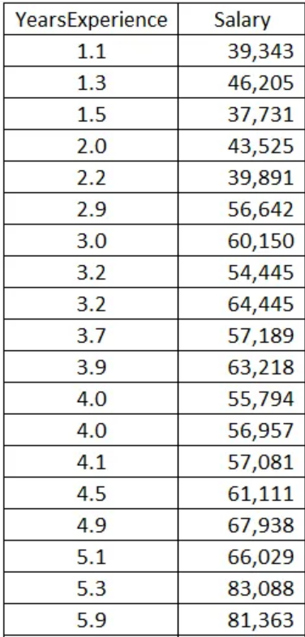
Simple Linear Regression with Python
“The scenario is you are a HR officer, you got a candidate with 5 years of experience. Then what is the best salary you should offer to him?”

Slide 77
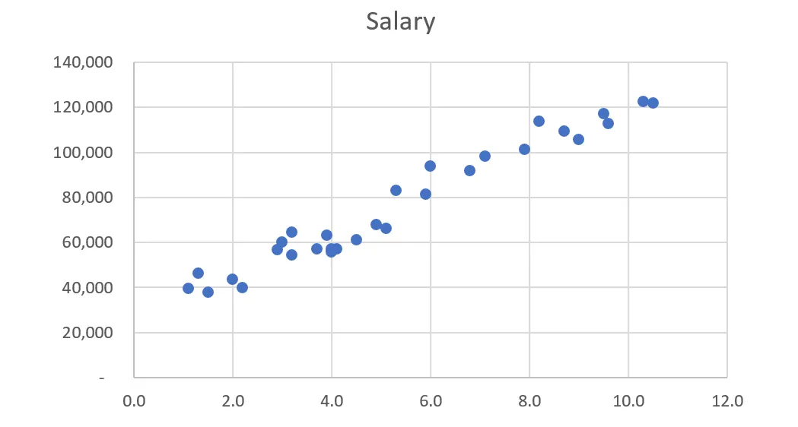
all the observations are not in a line. It means we cannot find out the equation to calculate the (y) value.
Look at the Scatter Plot again. Do you see it?
All the points is not in a line BUT they are in a line-shape! It’s linear!

Slide 78
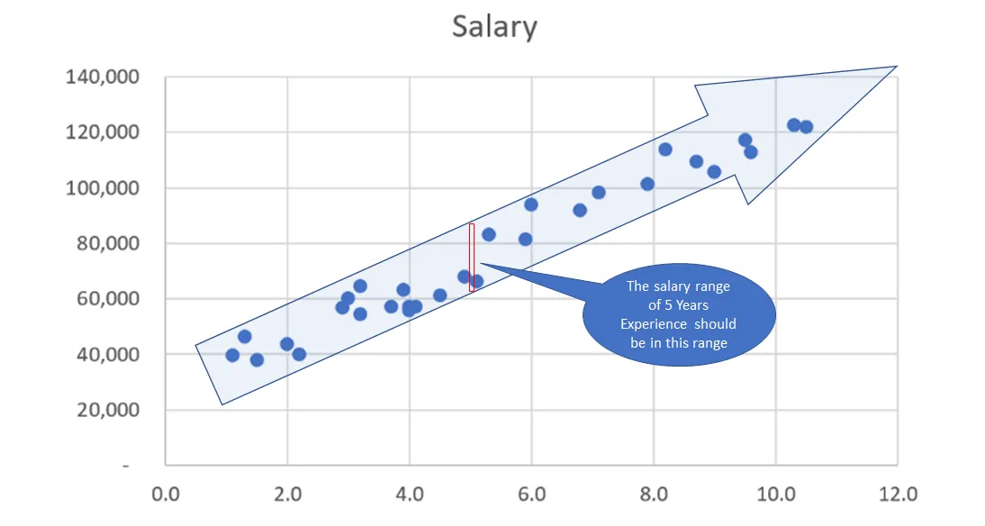
Based on our observation, we can guess that the salary range of 5 Years Experience should be in the red range.
Of course, we can offer to our candidate any number in that red range.
But how to pick the best number for him? It’s time to use Machine Learning to predict the best salary for our candidate.

Slide 79
Linear Regression with Python
import numpy as np
import matplotlib.pyplot as plt
import pandas as pd
# Importing the dataset
dataset = pd.read_csv('salary_data.csv')
X = dataset.iloc[:, :-1].values #get a copy of dataset exclude last column
y = dataset.iloc[:, 1].values #get array of dataset in column 1st
dataset: the table contains all values in our csv file
X: the first column which contains Years Experience array
y: the last column which contains Salary array

Slide 80
Next, we have to split our dataset (total 30 observations) into 2 sets:
training set which used for training and test set which used for testing:
# Splitting the dataset into the Training set and Test set
from sklearn.model_selection import train_test_split
X_train, X_test, y_train, y_test = train_test_split(X, y, test_size=1/3, random_state=0)
test_size=1/3: we will split our dataset (30 observations) into 2 parts (training set, test set) and the ratio of test set compare to dataset is 1/3 (10 observations will be put into the test set. You can put it 1/2 to get 50% or 0.5, they are the same. We should not let the test set too big; if it’s too big, we will lack of data to train. Normally, we should pick around 5% to 30%.
random_state: this is the seed for the random number generator. We can put an instance of the RandomState class as well. If we leave it blank or 0, the RandomState instance used by np.random will be used instead.

Slide 81
We already have the train set and test set, now we have to build the Regression Model:
# Fitting Simple Linear Regression to the Training set
from sklearn.linear_model import LinearRegression
regressor = LinearRegression()
regressor.fit(X_train, y_train)
regressor = LinearRegression(): our training model which will implement the Linear Regression.
regressor.fit: in this line, we pass the X_train which contains value of Year Experience and y_train which contains values of particular Salary to form up the model. This is the training process.

Slide 82
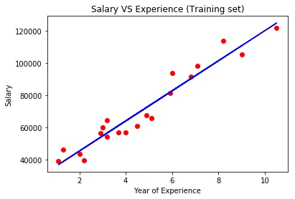
Let’s visualize our training model and testing model:
plt.scatter(X_train, y_train, color='red')
# Predicting the result of 5 Years Experience
y_pred = regressor.predict(5)

